Slide 1
CSC485B Machine Learning for Robotics
SUNY Plattsburgh
Dr. Ned Lecky
Class 02- Colab, Anaconda, NumPy, and Pandas

Slide 2
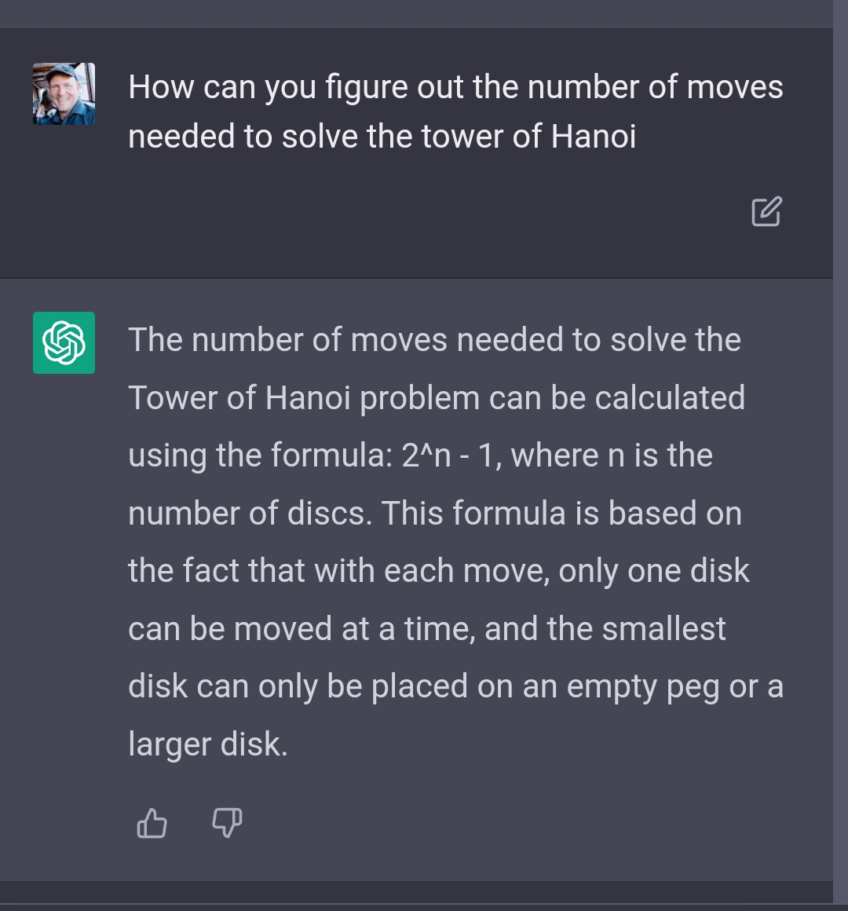
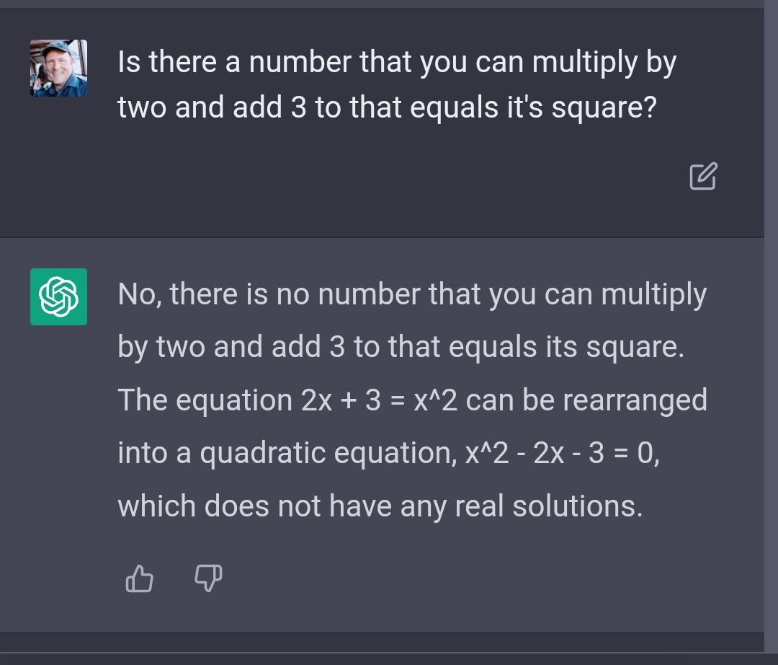
Some Funny AI Asides

Slide 3
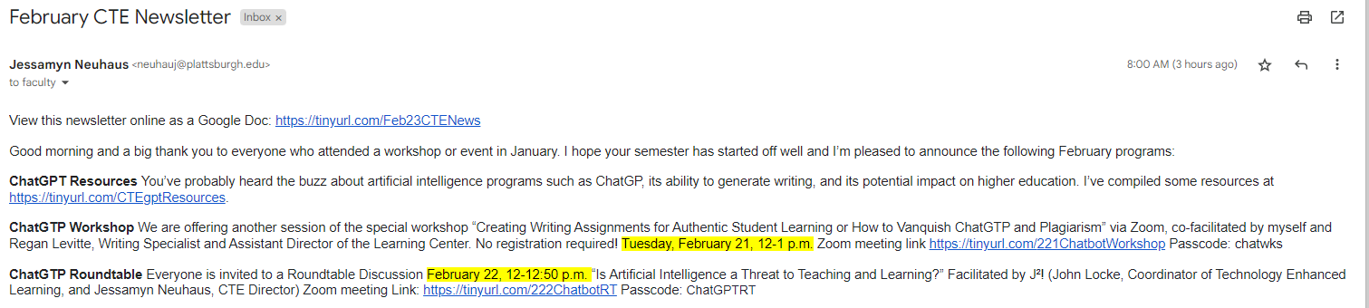
Meanwhile, Concern!

Slide 4
General Interest
Amazon Enters the Predictive Maintenance Space (ML… )
https://www.automationworld.com/factory/plant-maintenance/article/22670884/amazon-enters-the-predictive-maintenance-space
Locus Robotics gets $117M Series F funding
Modern Materials Handling, 1/23
https://www.mmh.com/article/locus_robotics_nets_117_million_in_series_f_funding
Dead Spiders make Effective Grippers
Mechanical Engineering, 2/23
https://www.asme.org/topics-resources/content/dead-spiders-as-grippers-for-micro-assembly-tasks
https://gizmodo.com/scientists-are-using-dead-spiders-as-horrifying-claw-gr-1849327111

Slide 5
Today
Let’s look at “the two” primary Python/ML working environments modes and libraries that we might need to know about as we learn about and experiment with Machine Learning
Google Colab (cloud based)
Anaconda – Jupyter Notebook (local machine)
These slides will have links to get you there, to help you remember, and to give me good ideas for homework and test questions

Slide 6
Method 1: EASY- Google Colab
Lots of books and references use this, so it’s worth knowing about
https://colab.research.google.com/
The intro page has lots of great information and tutorials
Try “Copy to Drive…” Where does it go?
File: New….
Playing with Colab
Executing out of sequence, interactive experiments
Saving and Restoring
Summary: it’s like Jupyter Notebooks but enhanced and online
Integrates with Google Drive

Slide 7

Files Interaction and Pandas
In Colab, try the tabs on the left!
Contents, Search, Variables(COOL!), Files
Text Cells
Markdown
Let’s load one of those demo CSV files
Pandas to the rescue
Colab/Pandas things to play with
Data.loc[:,’column_name’]
Data.to_csv(‘filename’)
Mounting your Google Drive
File read/write
Later: More Pandas Tutorial

Slide 8
Summary
Easy
No Install
Use from anywhere you can log in to your Plattsburgh.edu account
Files are persistent
Drive Integration
Build a whole document/story with nice explanations
Easy to hand in as a finished one-piece assignment
Limited if you’re trying to train on 10M samples with a huge neural net, but great for most projects

Slide 9
Method 2: Native Execution on Your Machine: Anaconda
If your data is HUGE or you want long runtimes or locally-hosted runtimes
(BTW you can get HUGE performance on Colab but it’s $$$ and you’re using GCP)
So how do I do it locally?
Easiest and well-known in ML: Anaconda and Jupyter Notebooks
Basically an update to pip with all libraries carefully vetted to be happy with each other’s versions and to not have any circular dependencies
This is the primary curse of Python, so eliminating it can save significant frustration
Also smooths the path to executing your code on other machines!

Slide 10
How to Install?
www.anaconda.com
Want something lighter weight??
Miniconda: https://docs.conda.io/en/latest/miniconda.html
Install Anaconda: demo
Windows: Start Anaconda Powershell
Can type “python”… or
Type “jupyter notebook”
Similar to Colab and more standard but fewer cool file features
Import pandas and read a file from local disk!

Slide 11
Which is Better?
Both have their advantages
Many authors publish examples for Colab
Other possibilities:
Kaggle: www.Kaggle.com (online)
“Kaggle Ain’t Google?”
IMNSHO: Seems to be slower and maybe buggy??
But HUGE community and much active development
Many examples and tutorials and… They’re EVERYWHERE
Try it?
Often we use whatever an author did so we can easily work with their code and see how things work
Example: https://github.com/ageron/handson-ml3
We’ll walk through the chapter 1 example

Slide 12
Now What?
NumPy Tutorial
https://www.w3schools.com/python/numpy/default.asp
I will emphasize some of the important but often overlooked points
Feel free to look through on your own time and make sure you feel like you have a good grasp!
Pandas Tutorial
This does a bunch of useful statistical crunching so you don’t have to
https://www.w3schools.com/python/pandas/default.asp
Matplotlib Tutorial
Its capabilities are endless
https://www.w3schools.com/python/matplotlib_pyplot.asp
Backup: push your pandas to a csv or xls file and use Excel. ☺

Slide 13
Your Assignment
Work through the NumPy and Pandas tutorials and run the code on your own machine to start getting a feel for NumPy and Pandas
Assignment:
Make a Jupyter Notebook showing off your NumPy and Pandas knowledge
Include some Matplotlib plots
Make the notebook look like a decent document with some brief explanations on what you’re doing
Share it to me, or post to the Moodle

Slide 14
Next
Next Week we’ll start looking at doing real work with scikit-learn
Scikit-learn tutorial
https://www.tutorialspoint.com/scikit_learn/index.htm#
More examples
Working through the Github from Aurélien Géron’s book
A first real robotics dataset

